Slide 1
Colab
Pitching the Idea!

Slide 2
Project Idea?
Collaboration
“Most great learning happens
in groups. Collaboration is
the stuff of growth.”
~ Ken Robinson

Slide 3
Problem and Its Significance
Day to day educational experiences?
Pair programming!
Interviews?
Competitive Programming!

Slide 4
Related Work?
Codeshare ~ Simplicity?!
Cloud9 ~ Usability?!
Plunker ~ Flexibility?

Slide 5
How to solve it?
Adaptable and Extendible collaboration environment.
Suitable collaborative educational utilities.
Build upon previous collaborative technologies experiences.

Slide 6
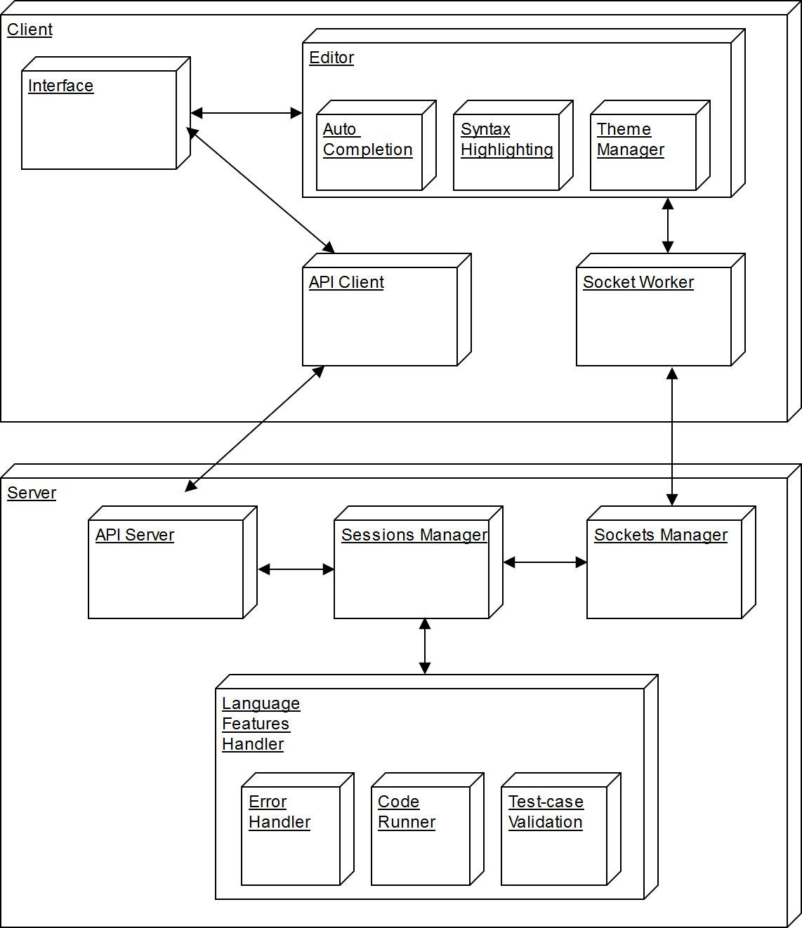
How?!
Client-server architecture.

Slide 7
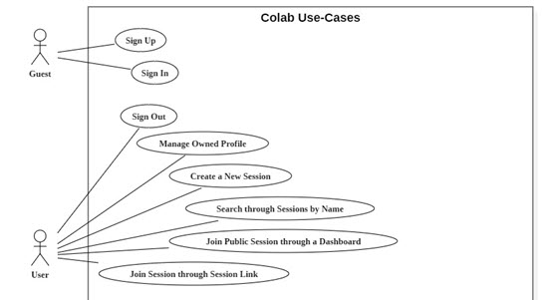
Use Cases

Slide 8
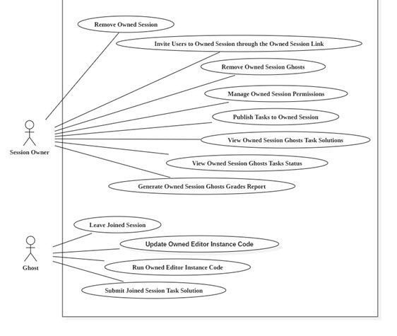
Use Cases

Slide 9
A glimpse of our progress!
DEMO
“Most people have the will to win,
few have the will to prepare to win.”
~ Bobby Knight

Slide 10
THANKS ☺

Slide 11
References
Code Share, https://codeshare.io/
Plunker, https://next.plnkr.co/
Cloud9, https://c9.io/

